Slide 1
Essential Variable Development Approaches: Some options based on GEO BON’s experience
ConnectinGEO EV Workshop
Bari, Italy
11-12 June 2015
Gary Geller
GEO Secretariat

Slide 2
Our Challenge
Select variables that
  Reflect the most important items to observe
  Provide guidance to the observation system
  Respond to user needs
  Lie between raw observations and user needs
Some significant obstacles
  Diverse users and user needs
  Heterogeneity (eg, for in situ data)
  Tension between science and applications
  “Pet” issues and variables

Slide 3

What Is Needed for Success?
“Good” EVs
Appropriately prioritized
Strong, broad community buy-in
Implementation plan (development & operationalization)
Confirmation of do-ability

Slide 4

How Should EVs Be Evaluated/Prioritized?
GCOS prioritization criteria
  Relevance (how important is it)
  Technical feasibility (can it be done)
  Cost effectiveness (is it affordable)
Readiness also important
  Algorithms, data

Slide 5
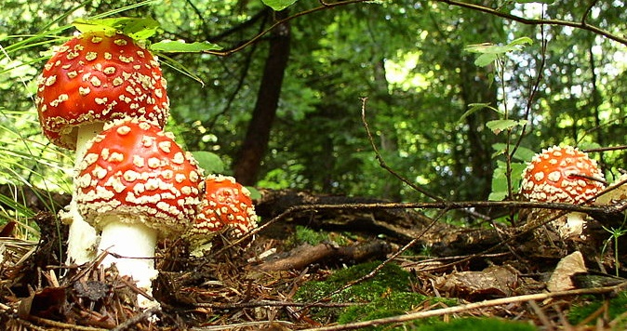
Some Approach Alternatives

Slide 6

0) Initial Workshop
  All alternatives could start with this
Purpose
  Start the process
  Establish some basic ideas
Objectives and outcomes
  Confirm interest and benefits
  Identify users and user needs
  Agree on EV definition
  Agree on scope
  Agree on path forward
  Explore or agree on Classes

Slide 7
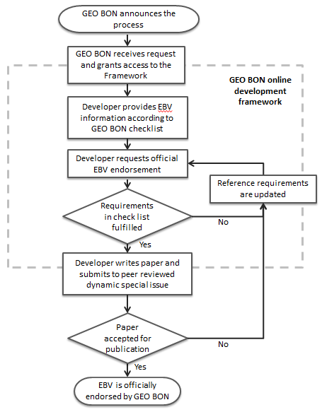
1) Current GEO BON Approach
Initial workshop
Basic Concepts &
Candidate EBVs
Science, 2013
Quiescent period
[EBV White Paper]
[Call for Participation]

Slide 8
1) Current GEO BON Approach
Utilizes an online development framework
  Each EBV proposer gets their own page
  EBV information is shown there
  Others can comment
Developers guided by a checklist
  Lists each EBV aspect they must address
When checklist completed
  Verified by GEO BON
  Given go-ahead to develop MS
  Submit to peer-reviewed journal
    Virtual special issue on EBVs
  If accepted—becomes an “official” EBV
Publishing is one level of community endorsement
Additional comments/issues possible

Slide 9

EBV Developer Checklist (draft)
Something like this is
useful for all alternatives

Slide 10

2) “Call for EVs” Approach
Facilitating organization puts out a call for proposals for EVs
Proposers submit candidate EVs
  Follow specific criteria they are given (eg, checklist)
Review panel prioritizes them
Threshold selected to separate Tier 1 and Tier 2

Slide 11
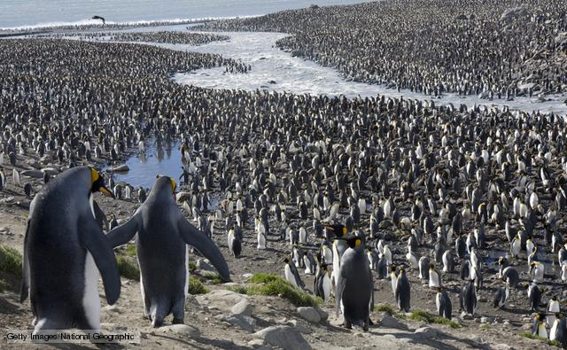
3) “Crowd Sourcing” Approach
Collect any and all EV suggestions from experts and community
  Hopefully based on user needs
Clean up list to adhere to criteria
Use Survey Monkey to get community input
  Score each candidate based on criteria
Scores used to create prioritized list
Put into Tier 1 and Tier 2

Slide 12
4) “Two-Step Process”
STEP 1: First cut
Identify the users
Identify specific set of user needs
  Eg, CBD document
Identify the information needed to address those needs
Identify EVs
STEP 2: Abstraction
Back off one level in specificity
Increase applicability and flexibility
Isolate EVs from changes in policy or specific requirements
Make science people more comfortable

Slide 13
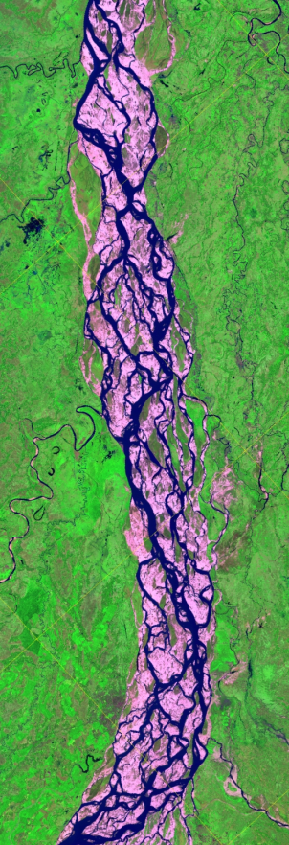
5) A Big Picture Perspective
Develop EVs in conjunction with end user organization
  UNFCCC, CBD…
  Converge, get approval
End user org inserts need for EVs in formal documents
  GEO can point to those docs in discussions with members
And
  Request that CEOS respond
  Consider developing “Satellite Supplement”
  (GCOS did this, CEOS responded…)

Slide 14

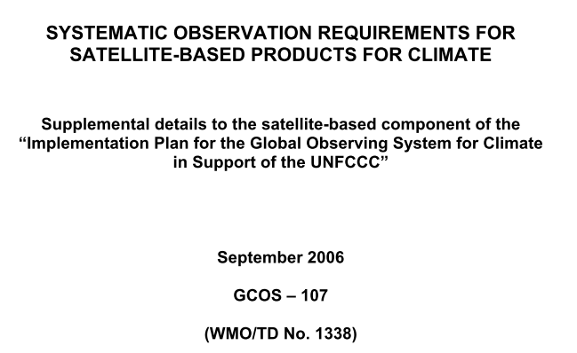
GCOS Satellite Supplement

Slide 15
Useful GCOS Documents
GCOS-82 (2003 Adequacy Report)
GCOS-92 (2004 Implementation Plan)
GCOS 107 & 154 (2006 & 2011 “Satellite Supplements”)
GCOS 138 (2010 Implementation Plan)
GCOS SC-XIX, Doc. 10.1 (2011-08-30; 1 page history)
Bojinski et al 2014. The Concept of Essential…BAMS September
GCOS Climate Monitoring Principles

Slide 16

GEO BON’s Biggest Challenges
Defining scope
  Users
  EBV definition (eg, always “state” variables?)
Prioritization (eg, checklist criteria)
What approach to use
Community buy-in

Slide 17
Still Much to Do
Initial workshop
Basic Concepts &
Candidate EBVs
Science, 2013
Quiescent period
[EBV White Paper]
[Call for Participation]

Slide 18
And More To Do: operationalization

Slide 19
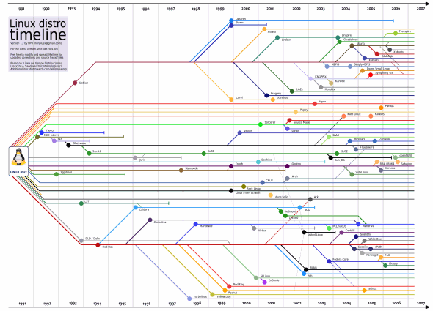
The Possibility of Splintering…
EBV concept has appeal to many groups
Little to stop groups from going off on their own
Possible
Would it be bad?

Slide 20

Additional Thoughts
Tier 1 and Tier 2
Curation
Criteria are important
Well-defined scope makes everyones lives easier
If the essential questions are defined the essential variables will be easy

Slide 21
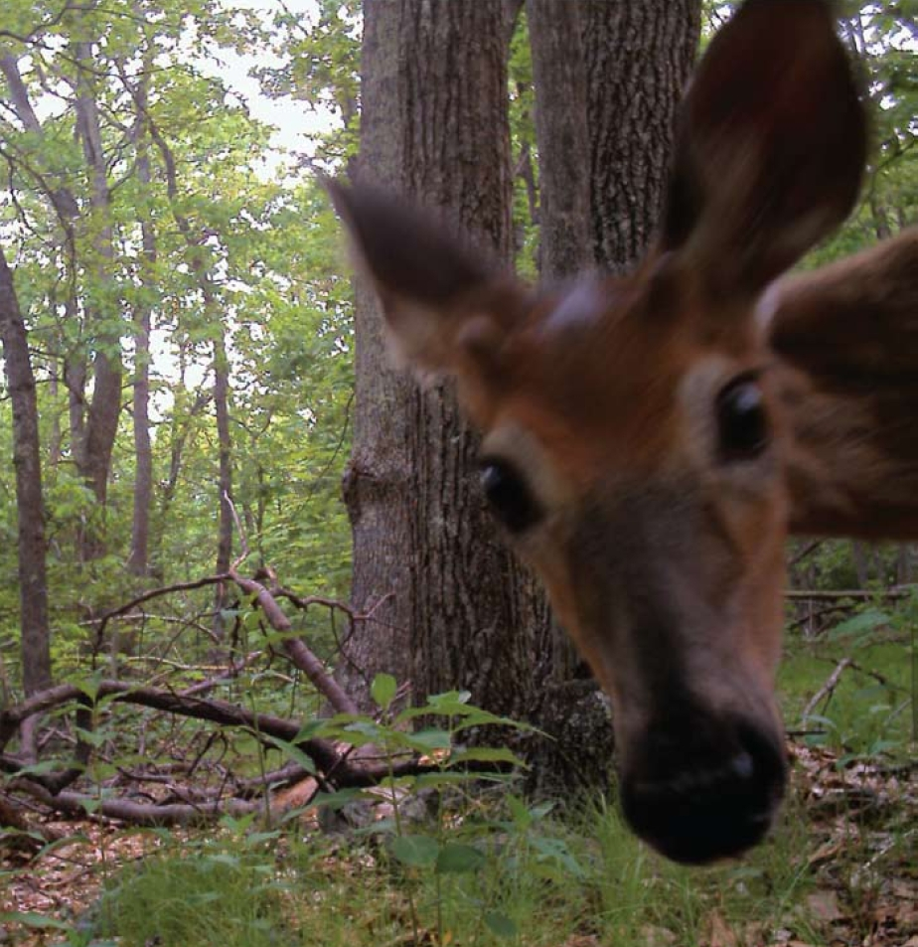
Wrapup: Lessons Learned (so far…)
Study the GCOS experience with ECVs
Best approach is not obvious
Need good leadership
Well-defined scope is essential

Slide 23
